Slide 1
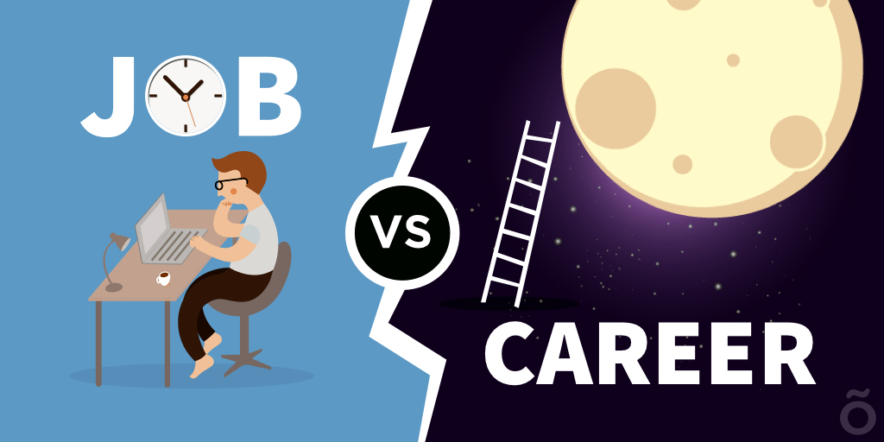
Job vs career
C.Raghava Rao

Slide 2
“Job” is defined as
A piece of work, esp. a specific task done as part of the routine of one's occupation or for an agreed price.
A post of employment; full-time or part-time position.
Anything a person is expected or obliged to do; duty; responsibility. It usually is considered to pertain to remunerative work (and sometimes also formal education).
A job can also be viewed as a contract between the employer and the employee.

Slide 3

"Career" is defined as
An occupation or profession, esp. one requiring special training, followed as one's lifework.
A person's progress or general course of action through life or through a phase of life, as in some profession or undertaking

Slide 4
Comparison chart
 | Career | Job
 | A career is the pursuit of a lifelong ambition or the general course of progression towards lifelong goals. | Job is an activity through which an individual can earn money. It is a regular activity in exchange of payment.
Requirements | Usually requires special learning that includes individualized components that develop abilities beyond that which training is capable of. | Education or Special training may or may not be required
Risk taking | A career may not mean stability of work as it encourages one to take risks. The risks are often internal and therefore planned. | A job is “safe”, as stability of work and income is there. However shifting priorities, especially in resource jobs, can abruptly change the demand and require relocation which is an unstable factor. Risks may be completely external.

Slide 5
Comparison chart
 | Career | Job
Time | Long term | Short term
Income | Varies depending on value to society or to some other entity. Non-monetary benefits may be higher. Salary is more common. | Varies by demand. More likely to be wage.
Contribution to society | May have high value as social change/progress may be possible. | May actually have a negative impact when counterproductive social practices are continued in the name of protecting jobs.

Slide 6

Jobs vs. Career
A job can be just going to work to earn a paycheck.
A career is a journey that includes all your jobs, experiences, and training in the same field or career cluster.

Slide 7
The real difference between a job and a career is your attitude
People who want a career are always thinking about their long-term goals. They are thinking about what they can do now to make those goals happen in the future.
Beginning job seekers often must work hard for little money. It might take a few years to earn bigger paychecks and have more interesting job duties, but these lower-level jobs can lead to great opportunities.

Slide 8
How do you advance on your journey?
Think of your career journey as climbing a ladder. Each step of the ladder could be a job that gives you valuable experiences.
At one job, you might pick up new skills.
At another, you might gain a new interest.
As you climb the ladder, your jobs might increase in responsibility or pay.

Slide 9


ALL THE BEST

